Slide 1


Gnog air an doras
Notes:
Knock on the door

Slide 2

Buail an clag
Notes:
Hit/ring the bell

Slide 3

Thoir sùil tron uinneig
Notes:
Have a look through the window

Slide 4
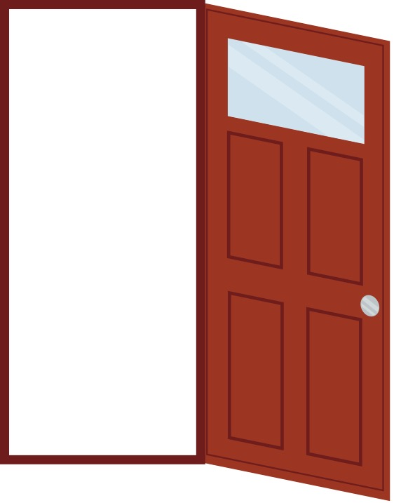
Thig a-steach
Notes:
Come inside

Slide 5
Cùm do theanga
Notes:
Keep quiet (Hold your tongue)

Slide 6
Tog do chas
Notes:
Lift your foot

Slide 7
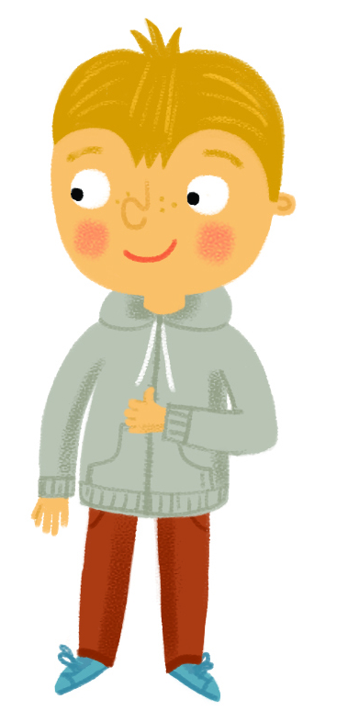
CC
Ciamar a tha sibh?
Notes:
How are you?

Slide 8
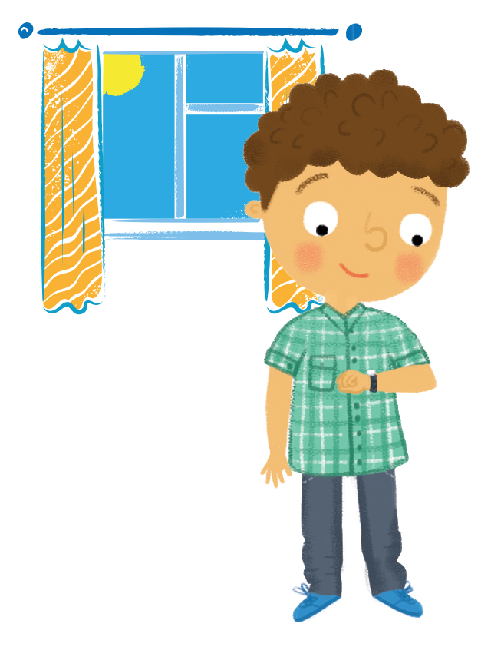
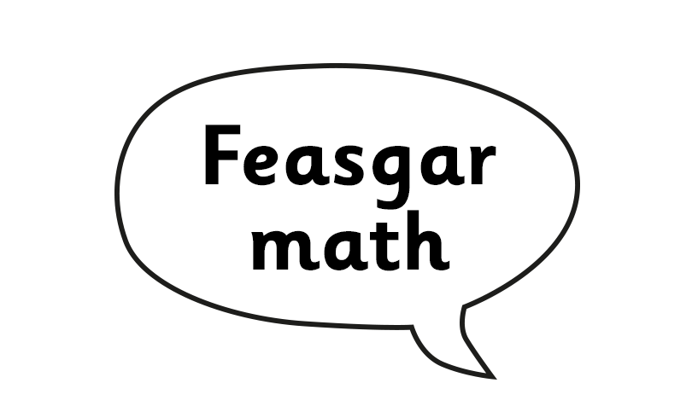
Notes:
Good afternoon

